Slide 1


Slide 2
Topics Covered
Handlers
Sample playbook of using handlers

Slide 3
Handlers – Running operation on change
Handlers are lists of tasks, not really anything different from regular tasks.
These handlers are referenced by an global unique name and are notified by notifiers.
If nothing notifies an handler, it will not run.
Regardless of how many tasks notify a handler, it will run only once.
These ‘notify’ actions are triggered at the end of each block of tasks in a play, and will only be triggered once even if notified by multiple different tasks.
For instance, multiple resources may indicate that apache needs to be restarted because they have changed a config file, but apache will only be bounced once to avoid unnecessary restarts.
Handlers also will run only at end of the play not before that.

Slide 4
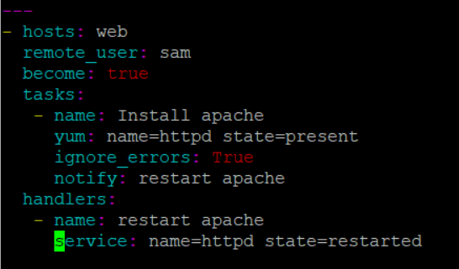
Sample playbook of using handlers

Slide 5
End…

